Slide 1

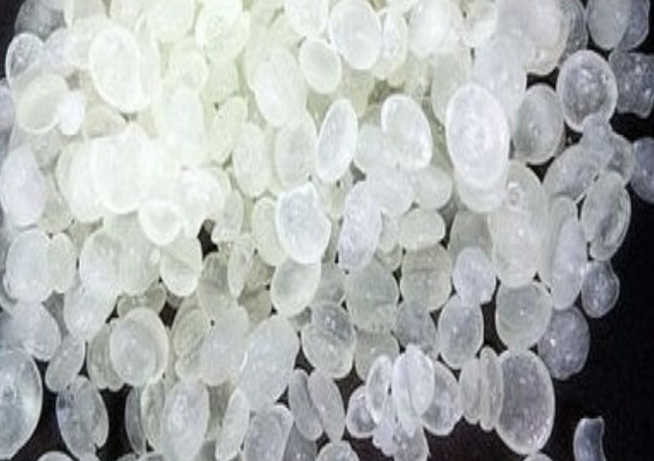

2015 – 2040
2015 – 2040
APAC DICYCLOPENTADIENE MARKET
APAC Dicyclopentadiene MARKET
FORECAST & OPPORTUNITIES
FORECAST & OPPORTUNITIES
Prepared for :
Prepared for :
MARKET INTELLIGENCE . CONSULTING
www.techsciresearch.com

Slide 2
Market Overview: APAC Dicyclopentadiene Market
APAC Dicyclopentadiene Demand, By Volume, 2015, 2020, 2021E, and 2040F (Tonnes)
APAC Dicyclopentadiene Demand, By Value, 2015, 2020, 2021E, and 2040F (USD Million)
The demand of Dicyclopentadiene in APAC region is anticipated to reach around 1759 thousand tonnes in 2040 due to increasing demand from the end-user industries and its surging demand for the manufacturing of Unsaturated polyester resins (UPR). APAC Dicyclopentadiene market stood at 617.7 thousand tonnes in 2020 with a decline in growth by 2.24 percent compared to 2019 due to lockdown and disruption of supply chain because of Covid-19.
Asia Pacific market of Dicyclopentadiene (DCPD) was valued at USD592.10 million in 2020 which is expected to grow at a CAGR of 8.00% by 2040. With increasing cost of crude oil and rise in production cost the prices of Dicyclopentadiene has increased in the past three years. The cost of production of C5 resins in the refineries have increased by around 2-4% in APAC region.
APAC Dicyclopentadiene Market Share, By Application, By Volume, 2021E
APAC Dicyclopentadiene Market Share, By Country, By Volume, 2020
Unsaturated polyester resins (UPR) applications is expected to remain dominant in APAC Region with a share of 52.65 percent in 2021E because its increasing use as a composite material in multiple industries. Furter, UPR growing usage in paints & coating, Laminate industry, etc. is expected to fuel the demand of DCPD for the forecast period. Petroleum resin (C5) is the second largest demand generating application of DCPD in Asia Pacific region with a market share of 22.21 percent in 2021E.
China is expected to remain the dominant country in terms of volume for Dicyclopentadiene market. The demand of Dicyclopentadiene in Asian Countries like Japan, South Korea, Vietnam and India is anticipated to rise with growing demand from paint & coating industry, plastic industry and rubber industry. As of now India is not producing EPDM rubber which is one of the growing application of DCPD. In coming years India is expected to have EPDM capacity which will fuel the demand of DCPD in coming years.
Source: TechSci Research

Slide 3

Recommendations for HPCL
Currently, in India there is no manufacturer of DCPD is present. Majority of the demand in the country is met through import from China and Brazil. UPR accounts for majority of the market of DCPD Demand followed by Petroleum resin. HPCL has a great opportunity to become the only producer of DCPD in the country.
The current consumption of EPDM in India is around 100 thousand tonnes and the market has grown significantly with an CAGR of 7.41% from 2015. However, in India due to non availability of DCPD Diene, DCPD grade EPDM are not produced in India and demand is of the product is fully met through import. By commissioning a capacity of DCPD, HPCL will have an edge to integrate downstream EPDM unit in the refinery to cater the surging demand of EPDM from Automobile and Construction sectors in India.
HPCL can target countries such as Malaysia, Sri Lanka, Middle East and African Nations and export DCPD to end user industries in these region. The burgeoning demand from end use industries of UPR, EPDM, Polydicyclopentadiene, petroleum resin, etc. is anticipated to create an export potential from the country.

